Slide 1
Reinforcement Learning (Chapter 22)
Dr. Shengquan Wang
Most slides are adopted from
Artificial Intelligence: A Modern Approach, 3rd ed. by Stuart Russell (UC Berkeley) and Peter Norvig (Google).
Dan Klein and Pieter Abbeel for CS188 Intro to AI at UC Berkeley.
Peter Norvig and Sebastian Thrun for Intro to Artificial Intelligence at Udacity.
Sutton, Richard S., and Andrew G. Barto. Reinforcement learning: An introduction.

Slide 2
Roadmap
By far: reasoning/planning with the known model.
The rest: learn a model from the data (machine learning)
MDP
Reinforcement Learning

Slide 3
Outline
Introduction

Slide 4

Review: MDP Grid World
State reward function: R(s)
Absorbing state: +100, -100
Others: -1
Markovian Transition model: P(s’|s, a) for Action a
Front: 0.8
Left: 0.1
Right: 0.1
Exception: bounced back by wall/obstacles.
-1 | -1 | -1 | +100
-1 |  | -1 | -100
-1 | -1 | -1 | -1
0.8
0.1
↑
0.1
0.1
↑
0.8
0.1

Slide 5
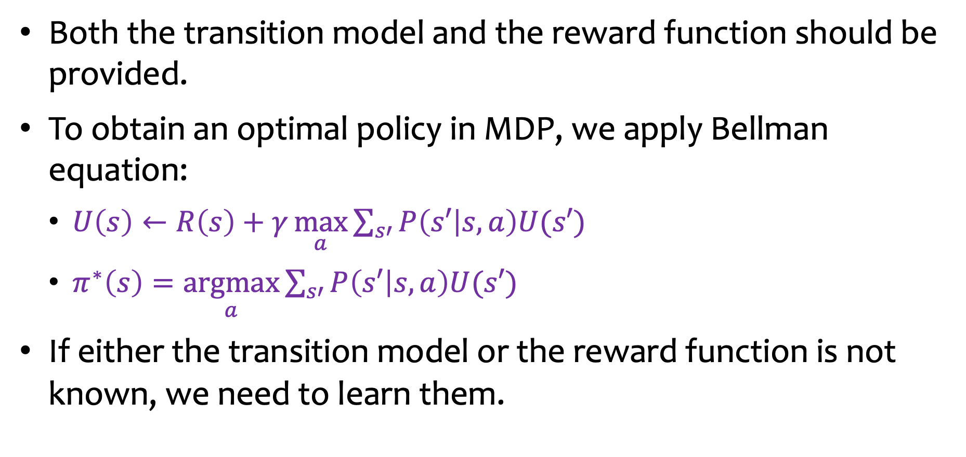
Assumptions of MDP
Both the transition model and the reward function should be provided.
To obtain an optimal policy in MDP, we apply Bellman equation:
$U\left(s\right)←R\left(s\right)+γ\underset{a}{\text{max}}{\sum_{s′}{P\left(s′ | s,a\right)U(s′)}}$
$π^{∗}\left(s\right)=\underset{a}{\text{arg}\text{max}}{\sum_{s′}{P\left(s′ | s,a\right)U(s′)}}$
If either the transition model or the reward function is not known, we need to learn them.

Slide 6
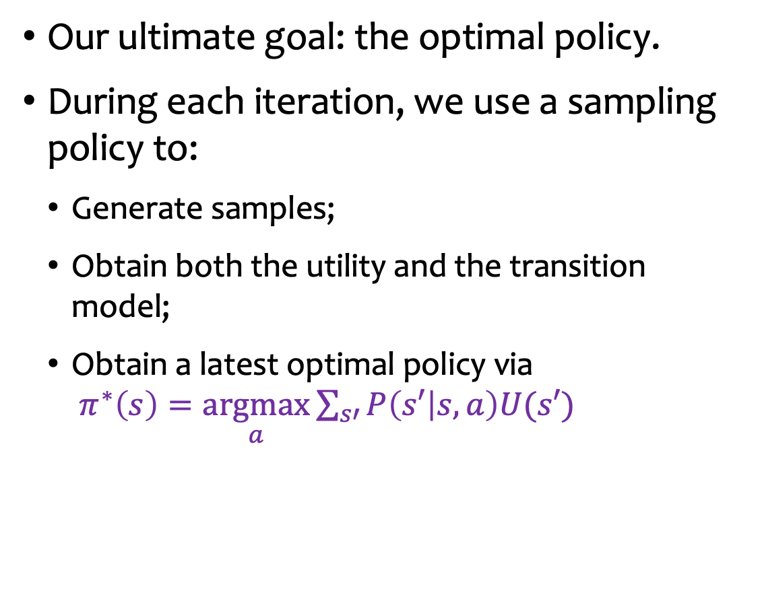
Reinforcement Learning (RL)
Our ultimate goal: the optimal policy.
During each iteration, we use a sampling policy to:
Generate samples;
Obtain both the utility and the transition model;
Obtain a latest optimal policy via $π^{∗}\left(s\right)=\underset{a}{\text{argmax}}{\sum_{s′}{P\left(s′ | s,a\right)U(s′)}}$
Sampling policy
Transition model and Utility
Latest optimal policy

Slide 7
Reinforcement Learning vs Policy Iteration
Sampling policy
New policy
Transition model and Utility
Policy evaluation
Latest optimal policy
Policy improvement

Slide 8
Three Tasks in RL
How to choose sampling policies?
How to learn transition model and the utility from samples?
How to obtain the optimal policy?
Sampling policy
Transition model and Utility
Latest optimal policy

Slide 9
Outline
Introduction
Exploitation and Exploration

Slide 10
Exploitation and Exploration
Find a dining place?
Usual Dining Place
Grand Opening

Slide 11
Multi-Armed Bandit Problem
Imagine you are facing multiple slot machines and each is configured with an unknown probability of how likely you can get a reward at one play.
Question: What is the best strategy to achieve highest long-term rewards?
Reward
Slot machines

Slide 12
Random Approach
We choose random walk as the sampling policy.
It converges very slowly:
The goal is to find the optimal policy.
Many samples which don’t contribute the optimal policy are wasted.

Slide 13
Greedy Approach
We use the latest optimal policy as the sampling policy.
It converges faster than the random approach.
It seldom converges to the optimal policy.
The early optimal policy by the greedy approach carries strong bias.
The early-learned model is not the same as the true environment.

Slide 14
Trade-off
Exploitation by greedy approach
to maximize its utility - as reflected in its current utility estimates.
Exploration by random approach
to maximize its long-term well-being.

Slide 15
ε-Greedy Approach: Combination
Choose a random action with probability ε(=1/t, t is the current time) and the greedy policy otherwise.
It will converge to an optimal policy.

Slide 16
Similar to Local Search: Simulated Annealing
Escaping local maxima by allowing downhill moves.

Slide 17
Benefit of ε-Greedy Approach
Don’t waste too much resource on sampling the actions which are not optimal actions.

Slide 18
Three Tasks in RL
How to choose sampling policies?
How to learn the transition model and the utility from samples?
How to obtain the optimal policy?
Sampling policy
Transition model and Utility
Latest optimal policy

Slide 19
Example: A Grid World
Given a policy π:
The agent executes a set of trials in the environment using its policy π.
In each trial,
The agent starts in any state and experiences a sequence of state transitions until it reaches b4 or c4.
It generates a trajectory of (state, action, reward): s, a, r, s’, a’, r’, s’’, a’’, r’’, …
Task: we aim to learn the utility function U(s).
-1 | -1 | -1 | +100
-1 |  | -1 | -100
-1 | -1 | -1 | -1
c
b
a
1
2
3
4

Slide 20
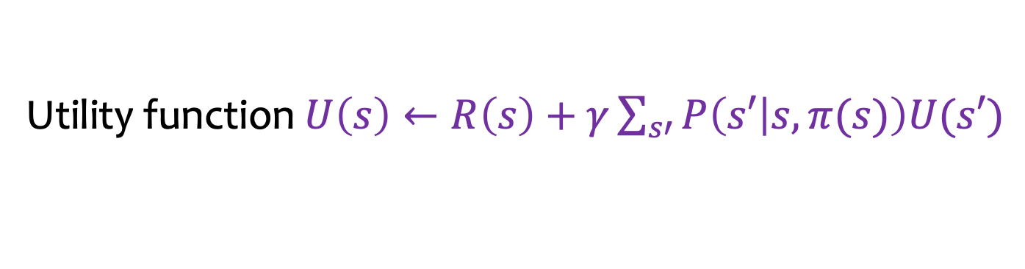
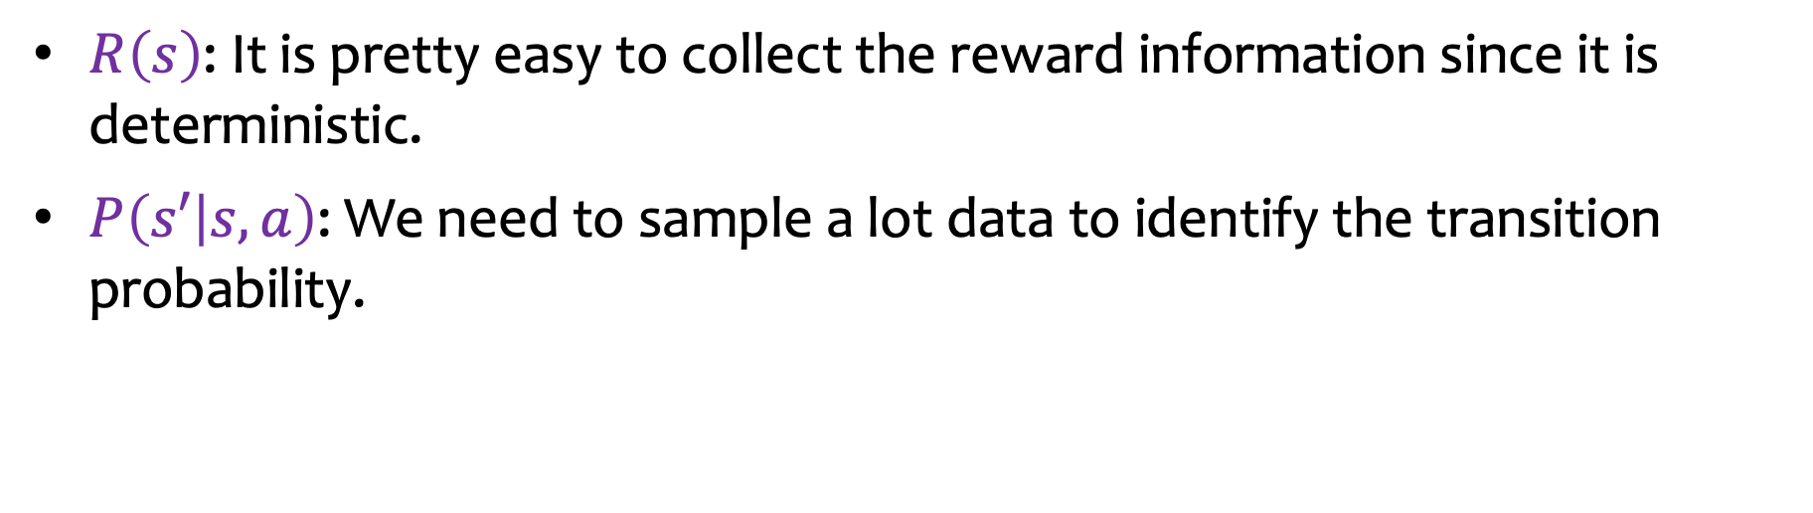
Direct Approach: Model-Based
-1 | -1 | -1 | +100
-1 |  | -1 | -100
-1 | -1 | -1 | -1
c
b
a
1
2
3
4
Utility function $U\left(s\right)←R\left(s\right)+γ\sum_{s′}{P\left(s′ | s,π(s)\right)U(s′)}$
$R\left(s\right)$: It is pretty easy to collect the reward information since it is deterministic.
$P\left(s′ | s,a\right)$: We need to sample a lot data to identify the transition probability.

Slide 21
Direct Approach: Model-Free
Problem: Model-based is too costly.
Question: Can we obtain the utility without the transition model?
Answer: Yes!
-1 | -1 | -1 | +100
-1 |  | -1 | -100
-1 | -1 | -1 | -1
c
b
a
1
2
3
4

Slide 22
Outline
Introduction
Exploitation and Exploration
Model-Free Utility Learning

Slide 23
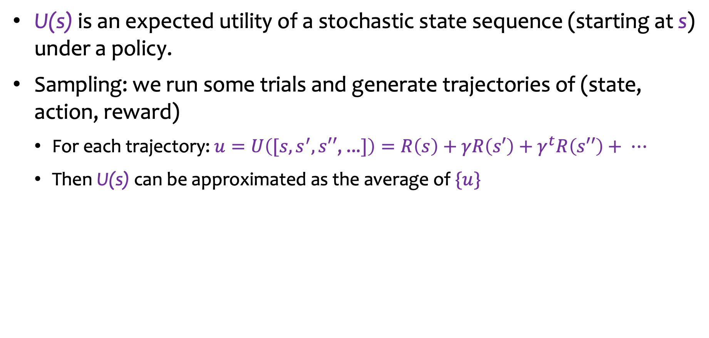
Recall: Expected Utility
U(s) is an expected utility of a stochastic state sequence (starting at s) under a policy.
Sampling: we run some trials and generate trajectories of (state, action, reward)
For each trajectory: $u=U\left([s,s^{′},s′′\text{, ...}]\right)=R\left(s\right)+γR\left(s′\right)+γ^{t}R\left(s′′\right)+ ⋯$
Then U(s) can be approximated as the average of $\{u\}$

Slide 24


Overall Mean
After running n trials with n utility values ${\{u}_{i}\}$: $U\left(s\right)= \frac{1}{n}\left(u_{1}+u_{2}\text{+}⋯\text{+}u_{n}\right)$
Drawback: we need to keep track all ${\{u}_{i}\}$ , too much memory.

Slide 25

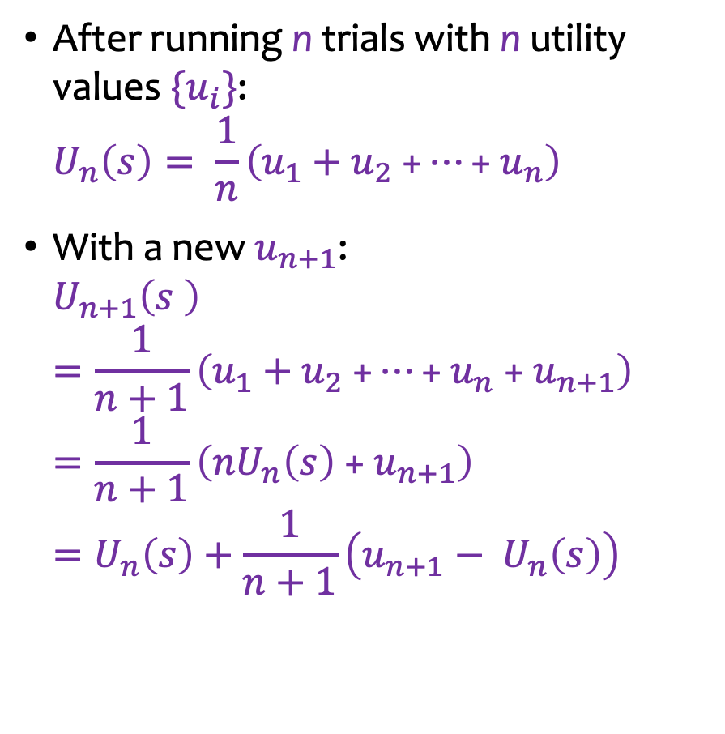
Incremental Mean
After running n trials with n utility values ${\{u}_{i}\}$: $U_{n}\left(s\right)= \frac{1}{n}\left(u_{1}+u_{2} \text{+}⋯\text{+}{ u}_{n}\right)$
With a new $u_{n+1}\text{:}$ $U_{n+1}\left(s \right)=\frac{1}{n+1}\left(u_{1}+u_{2} \text{+}⋯\text{+ }u_{n} \text{+ }u_{n+1}\right)=\frac{1}{n+1}\left({nU}_{n}\left(s\right) \text{+}{ u}_{n+1}\right)=U_{n}\left(s\right)+\frac{1}{n+1}\left({u_{n+1}− U}_{n}\left(s\right)\right)$
Incremental implementation:
$U\left(s\right)← U\left(s\right)+\frac{1}{n+1}\left(u_{n+1}−U(s)\right)$
Generalization: $U\left(s\right)←U\left(s\right)+\frac{1}{N(s)}\left(u−U(s)\right)$

Slide 26
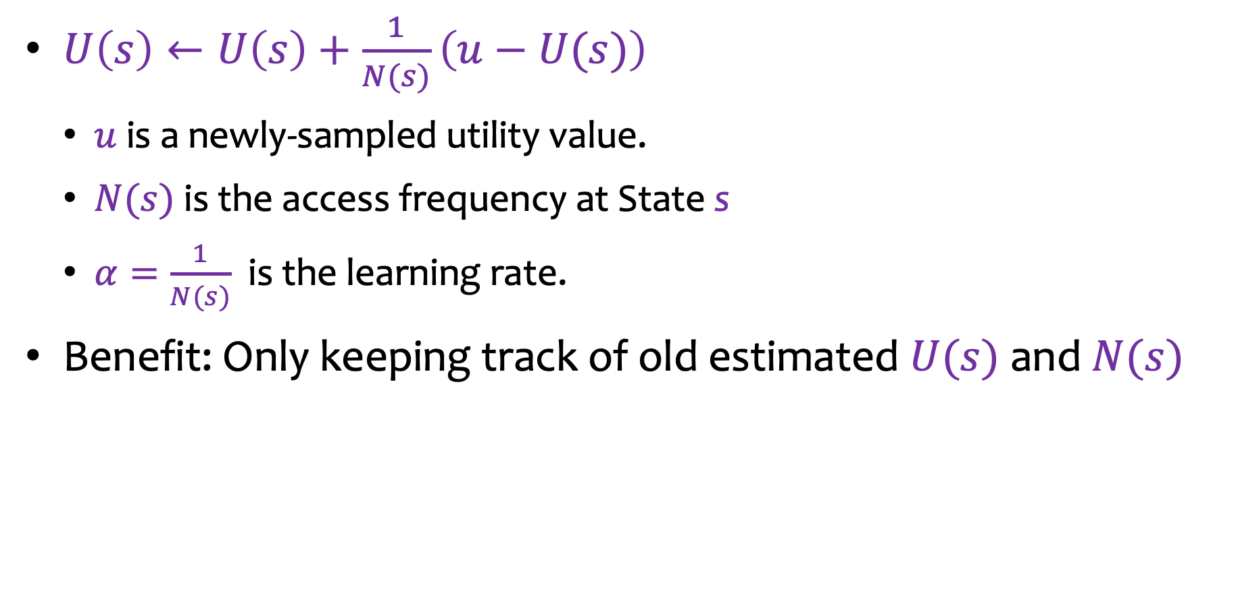

Incremental Mean (cont’d)
$U\left(s\right)←U\left(s\right)+\frac{1}{N(s)}\left(u−U(s)\right)$
$u$ is a newly-sampled utility value.
$N(s)$ is the access frequency at State s
$α=\frac{1}{N(s)}$ is the learning rate.
Benefit: Only keeping track of old estimated $U(s)$ and $N(s)$

Slide 27
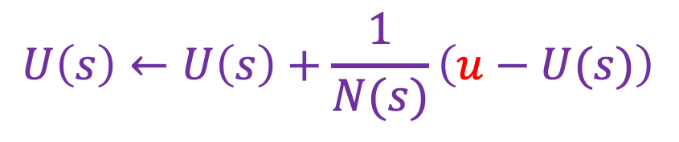
How to Sample Individual $u$
$$U\left(s\right)←U\left(s\right)+\frac{1}{N(s)}\left(u−U(s)\right)$$
Monte Carlo (MC) Method
Temporal-Difference (TD) Method

Slide 28
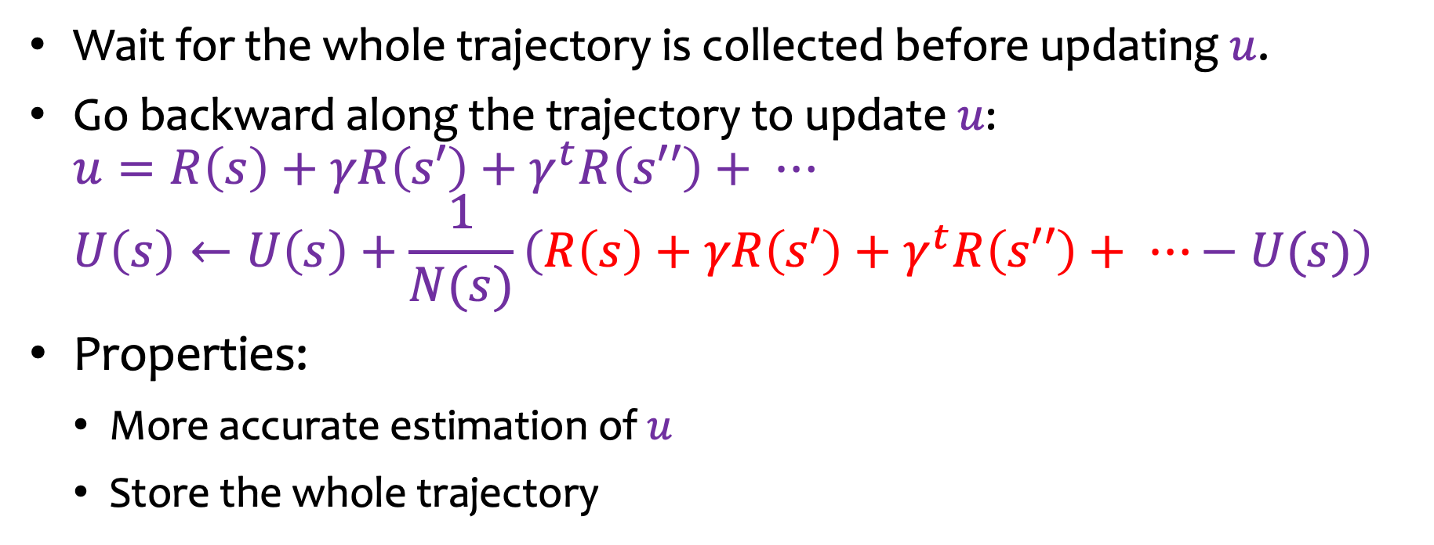
Monte Carlo (MC) Method
Wait for the whole trajectory is collected before updating $u$.
Go backward along the trajectory to update $u$: $u=R\left(s\right)+γR\left(s′\right)+γ^{t}R\left(s′′\right)+ ⋯$ $U\left(s\right)←U\left(s\right)+\frac{1}{N(s)}\left(R\left(s\right)+γR\left(s′\right)+γ^{t}R\left(s′′\right)+ ⋯−U(s)\right)$
Properties:
More accurate estimation of $u$
Store the whole trajectory

Slide 29
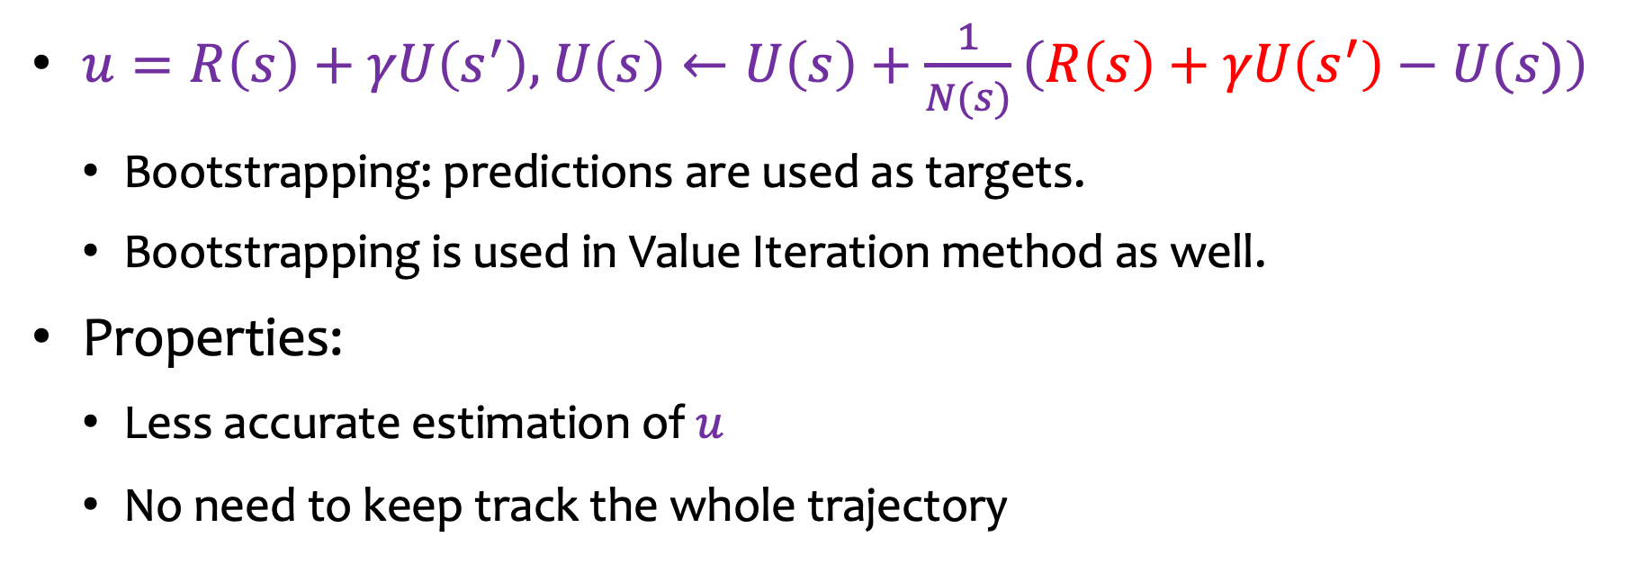
Temporal-Difference (TD) Method
$u=R\left(s\right)+γU\left(s^{′}\right),$ $U\left(s\right)←U\left(s\right)+\frac{1}{N(s)}\left(R\left(s\right)+γU\left(s^{′}\right)−U(s)\right)$
Bootstrapping: predictions are used as targets.
Bootstrapping is used in Value Iteration method as well.
Properties:
Less accurate estimation of $u$
No need to keep track the whole trajectory

Slide 30
Three Tasks in RL
How to choose sampling policies?
How to learn the transition model and the utility from samples?
How to obtain the optimal policy?
Sampling policy
Transition model and Utility
Latest optimal policy

Slide 31
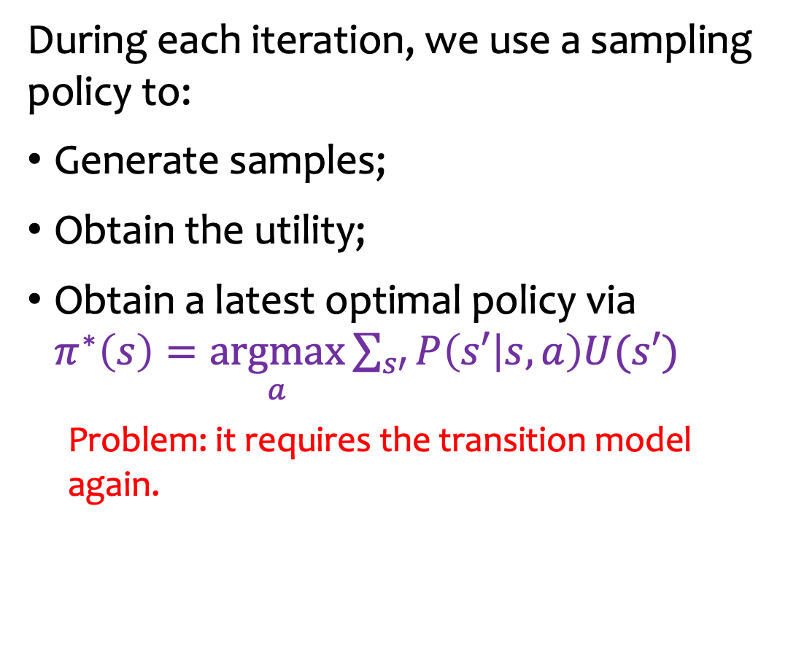
Issue
During each iteration, we use a sampling policy to:
Generate samples;
Obtain the utility;
Obtain a latest optimal policy via $π^{∗}\left(s\right)=\underset{a}{\text{argmax}}{\sum_{s′}{P\left(s′ | s,a\right)U(s′)}}$
Problem: it requires the transition model again.
Sampling policy
Transition model and Utility
Latest optimal policy

Slide 32
Outline
Introduction
Exploitation and Exploration
Model-Free Utility Learning
Another Utility Model: Q-Value

Slide 33

Q-Value: Another Utility Model
$U\left(s\right)$: an expected utility of a stochastic state sequence starting at $s$ under an optimal policy.
$Q\left(s,a\right)$: an expected utility of a stochastic (state, action) sequence starting at $\left(s,a\right)$ under a policy.

Slide 34
Example
84.7 |  | 92.0 |  | 94.9 |  | +100
84.6 | 90.8 | 87.3 | 94.6 | 91.2 | 95.9
78.1 |  | 91.9 |  | 77.0
85.0 |  |  |  | 73.1 |  | -100
52.5 | 74.8 |  |  | 64.1 | -57.7
45.1 |  |  |  | 46.9
78.8 |  | 53.8 |  | 67.3 |  | -74.0
49.5 | 51.7 | 50.6 | 61.4 | 53.6 | 34.6 | 48.4 | 14.6
55.1 |  | 53.2 |  | 60.6 |  | 1.2
c
b
a
1
2
3
4

Slide 35
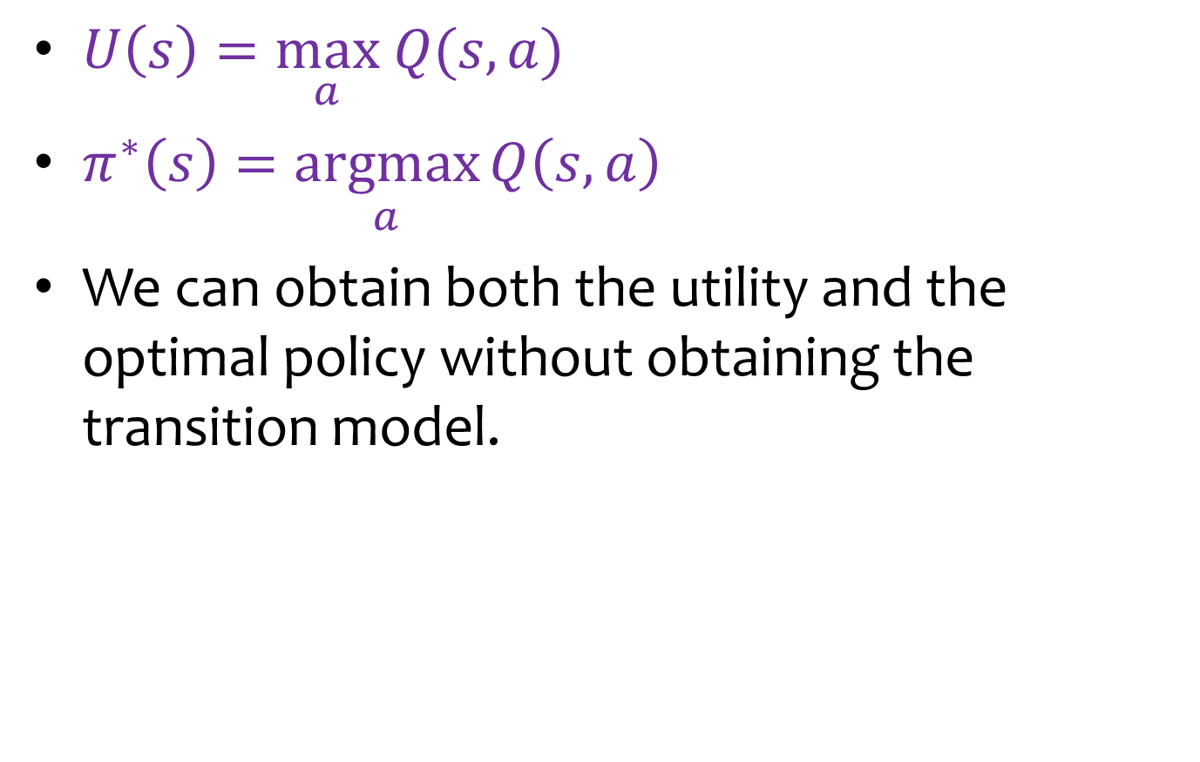
Q-Value Properties under Optimal Policy
$U\left(s\right)=\underset{a}{\text{max}} Q(s,a)$
$π^{∗}\left(s\right)=\underset{a}{\text{arg}\text{max}}{Q\left(s,a\right)}$
We can obtain both the utility and the optimal policy without obtaining the transition model.

Slide 36
How to learn Q-values?

Slide 37

Recall: Learning $U\left(s\right)$
Model-free MC $U\left(s\right)←U\left(s\right)+\frac{1}{N(s)}\left(R\left(s\right)+γR\left(s′\right)+γ^{t}R\left(s′′\right)+ ⋯−U(s)\right)$
Model-free TD $U\left(s\right)←U\left(s\right)+\frac{1}{N(s)}\left(R\left(s\right)+γU\left(s^{′}\right)−U(s)\right)$
Our focus on learning Q(s,a): model-free TD

Slide 38
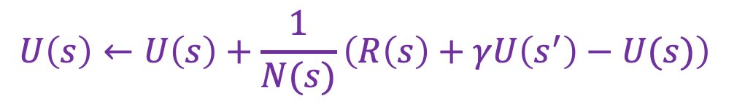
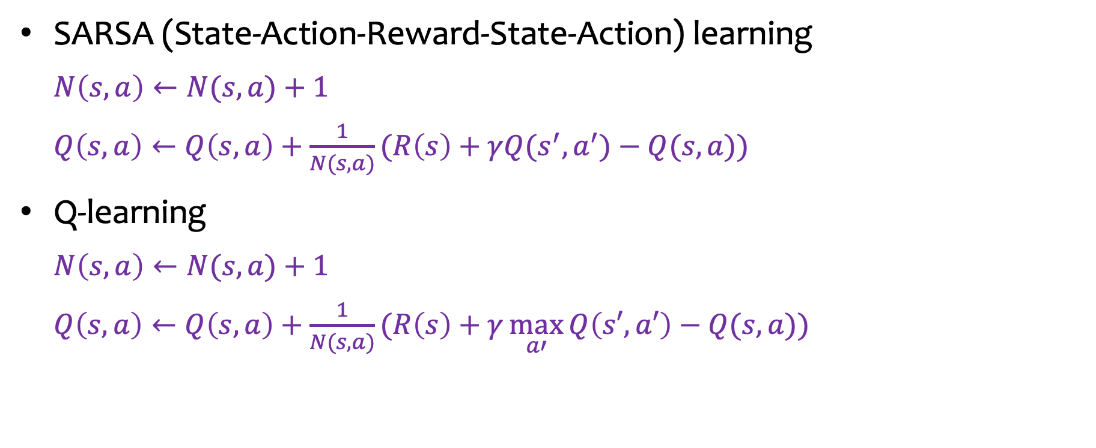
Model-Free TD Methods
$$U\left(s\right)←U\left(s\right)+\frac{1}{N(s)}\left(R\left(s\right)+γU\left(s^{′}\right)−U(s)\right)$$
SARSA (State-Action-Reward-State-Action) learning
$N\left(s,a\right)←N(s,a)$ + 1
$Q\left(s,a\right)←Q\left(s,a\right)+\frac{1}{N(s,a)}(R\left(s\right)+γQ(s^{′},a^{′})−Q(s,a))$
Q-learning
$N\left(s,a\right)←N(s,a)\text{ + 1}$
$Q\left(s,a\right)←Q\left(s,a\right)+\frac{1}{N(s,a)}(R\left(s\right)+γ\underset{a′}{\text{max}}{Q\left(s′,a′\right)}−Q(s,a))$

Slide 39
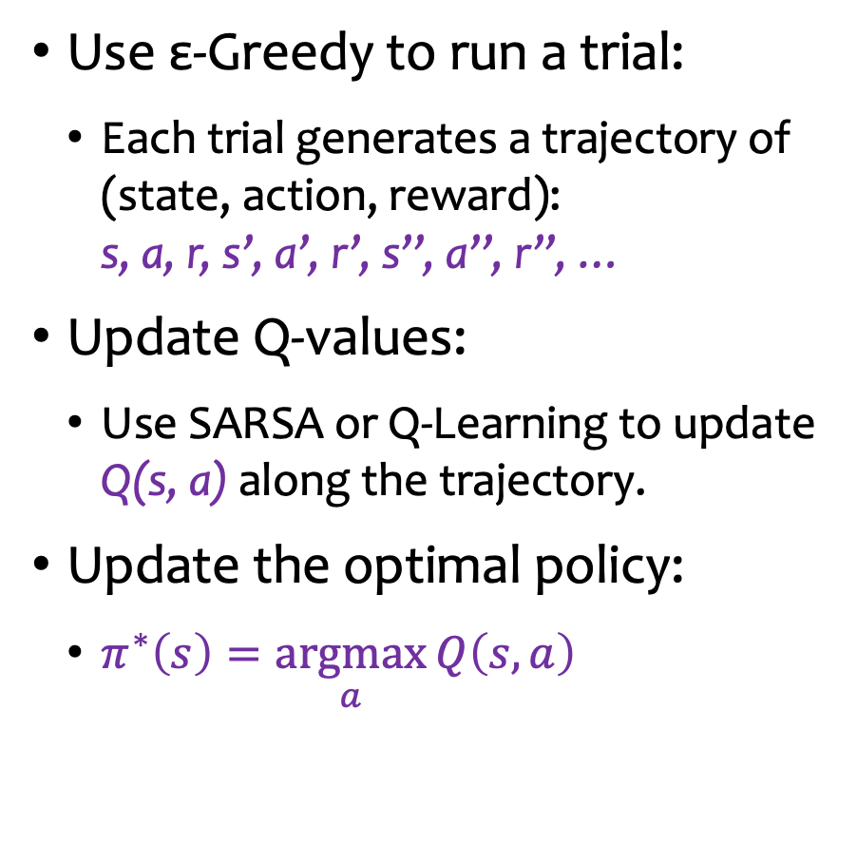
Workflow
Use ε-Greedy to run a trial:
Each trial generates a trajectory of (state, action, reward): s, a, r, s’, a’, r’, s’’, a’’, r’’, …
Update Q-values:
Use SARSA or Q-Learning to update Q(s, a) along the trajectory.
Update the optimal policy:
$π^{∗}\left(s\right)=\underset{a}{\text{argmax}}{Q\left(s,a\right)}$
Sampling policy
ε-Greedy
Q-value update
SARSA or Q-Learning
Latest optimal policy

Slide 40


Example: Initial Optimal Policy
$$γ=1$$
$$ε=0.1$$
$$Q\left(s,a\right)$$
0.0 |  | 0.0 |  | 0.0 |  | +100
0.0 | 0.0 | 0.0 | 0.0 | 0.0 | 0.0
0.0 |  | 0.0 |  | 0.0
0.0 |  |  |  | 0.0 |  | -100
0.0 | 0.0 |  |  | 0.0 | 0.0
0.0 |  |  |  | 0.0
0.0 |  | 0.0 |  | 0.0 |  | 0.0
0.0 | 0.0 | 0.0 | 0.0 | 0.0 | 0.0 | 0.0 | 0.0
0.0 |  | 0.0 |  | 0.0 |  | 0.0
Optimal action: highlighted in red
c
b
a
1
2
3
4
Since all Q-values are zero for any state-action pair, any action at any state is an optimal action.

Slide 41
Example: Initial ε-Greedy Sampling Policy
$$Q\left(s,a\right)$$
0.0 |  | 0.0 |  | 0.0 |  | +100
0.0 | 0.0 | 0.0 | 0.0 | 0.0 | 0.0
0.0 |  | 0.0 |  | 0.0
0.0 |  |  |  | 0.0 |  | -100
0.0 | 0.0 |  |  | 0.0 | 0.0
0.0 |  |  |  | 0.0
0.0 |  | 0.0 |  | 0.0 |  | 0.0
0.0 | 0.0 | 0.0 | 0.0 | 0.0 | 0.0 | 0.0 | 0.0
0.0 |  | 0.0 |  | 0.0 |  | 0.0
c
b
a
1
2
3
4
Due to many optimal action options, the ε-Greedy sampling policy will choose many random actions.
It might take a long time to reach the terminal state to have a complete trial.

Slide 42

Example: An Initial Sampling Trajectory
$$Q\left(s,a\right)$$
0.0 |  | 0.0 |  | 0.0 |  | +100
0.0 | 0.0 | 0.0 | 0.0 | 0.0 | 0.0
0.0 |  | 0.0 |  | 0.0
0.0 |  |  |  | 0.0 |  | -100
0.0 | 0.0 |  |  | 0.0 | 0.0
0.0 |  |  |  | 0.0
0.0 |  | 0.0 |  | 0.0 |  | 0.0
0.0 | 0.0 | 0.0 | 0.0 | 0.0 | 0.0 | 0.0 | 0.0
0.0 |  | 0.0 |  | 0.0 |  | 0.0
c
b
a
1
2
3
4
There are many random actions and some drifting and bouncing-back.

Slide 43


Example: Updated Access Frequency and Q-Values after Some Trials
$$N\left(s,a\right)$$
$$Q\left(s,a\right)$$
14 |  | 10 |  | 14 |  | +100
13 | 384 | 19 | 447 | 14 | 693
22 |  | 20 |  | 20
342 |  |  |  | 250 |  | -100
7 | 11 |  |  | 190 | 15
7 |  |  |  | 14
194 |  | 10 |  | 167 |  | 14
7 | 10 | 147 | 16 | 16 | 13 | 36 | 28
6 |  | 9 |  | 12 |  | 535
45.4 |  | 61.1 |  | 78.9 |  | +100
44.9 | 77.4 | 60.9 | 90.6 | 79.0 | 95.0
28.7 |  | 53.4 |  | 67.6
58.8 |  |  |  | 73.8 |  | -100
19.7 | 35.0 |  |  | 33.9 | -55.8
26.2 |  |  |  | 11.1
35.8 |  | 8.4 |  | 49.1 |  | -81.6
15.4 | 13.5 | 16.4 | 6.1 | -0.9 | 4.2 | 18.7 | -9.7
5.3 |  | -0.0 |  | 8.7 |  | 0.0
c
b
a
1
2
3
4
1
2
3
4

Slide 44
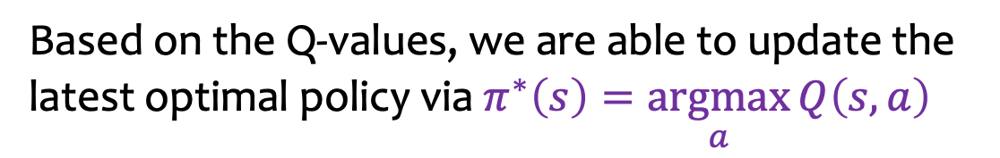
Example: Latest Optimal Policy
$$Q\left(s,a\right)$$
45.4 |  | 61.1 |  | 78.9 |  | +100
44.9 | 77.4 | 60.9 | 90.6 | 79.0 | 95.0
28.7 |  | 53.4 |  | 67.6
58.8 |  |  |  | 73.8 |  | -100
19.7 | 35.0 |  |  | 33.9 | -55.8
26.2 |  |  |  | 11.1
35.8 |  | 8.4 |  | 49.1 |  | -81.6
15.4 | 13.5 | 16.4 | 6.1 | -0.9 | 4.2 | 18.7 | -9.7
5.3 |  | -0.0 |  | 8.7 |  | 0.0
c
b
a
1
2
3
4
Based on the Q-values, we are able to update the latest optimal policy via $π^{∗}\left(s\right)=\underset{a}{\text{argmax}}{Q\left(s,a\right)}$

Slide 45
How does SARSA and Q-Learning update Q-values differently?

Slide 46
Outline
Introduction
Exploitation and Exploration
Model-Free Utility Learning
Another Utility Model: Q-Value
SARSA Illustration

Slide 47
Latest Access Frequency and Q-Values
$$N\left(s,a\right)$$
$$Q\left(s,a\right)$$
6 |  | 3 |  | 1 |  | +100
10 | 5 | 5 | 12 | 0 | 25
11 |  | 3 |  | 1
5 |  |  |  | 9 |  | -100
18 | 9 |  |  | 55 | 2
13 |  |  |  | 4
6 |  | 4 |  | 28 |  | 4
8 | 17 | 3 | 20 | 1 | 8 | 8 | 8
6 |  | 4 |  | 4 |  | 77
-2.4 |  | -1.8 |  | 41.0 |  |  | +100
-2.4 | 16.4 | -1.8 | 60.8 | 0.0 |  | 88.8
-2.4 |  | -1.8 |  | 3.4
-2.9 |  |  |  | 45.8 |  |  | -100
-2.9 | -2.9 |  |  | 12.2 | -101.0 | -101.0
-2.9 |  |  |  | -51.5
-2.6 |  | -1.9 |  | 11.0 |  |  | -101.0
-2.5 | -2.2 | -2.0 | 0.5 | -2.0 |  | -2.1 | -15.0 | -14.9
-2.4 |  | -2.1 |  | -1.9 |  |  | -3.7
c
b
a
1
2
3
4
1
2
3
4
Trajectory: (a2,E,-1) --> (a3,N,-1)< --> (a2,E,-1) --> (a3,N,-1) --> (b3,N,-1)> --> b4

Slide 48
Updating Access Frequency and Q-Values
$$N\left(s,a\right)$$
$$Q\left(s,a\right)$$
6 |  | 3 |  | 1 |  | +100
10 | 5 | 5 | 12 | 0 | 25
11 |  | 3 |  | 1
5 |  |  |  | 9 |  | -100
18 | 9 |  |  | 55 | 2
13 |  |  |  | 4
6 |  | 4 |  | 28 |  | 4
8 | 17 | 3 | 20 | 1 | 8 | 8 | 8
6 |  | 4 |  | 4 |  | 77
-2.4 |  | -1.8 |  | 41.0 |  |  | +100
-2.4 | 16.4 | -1.8 | 60.8 | 0.0 |  | 88.8
-2.4 |  | -1.8 |  | 3.4
-2.9 |  |  |  | 45.8 |  |  | -100
-2.9 | -2.9 |  |  | 12.2 | -101.0 | -101.0
-2.9 |  |  |  | -51.5
-2.6 |  | -1.9 |  | 11.0 |  |  | -101.0
-2.5 | -2.2 | -2.0 | 0.5 | -2.0 |  | -2.1 | -15.0 | -14.9
-2.4 |  | -2.1 |  | -1.9 |  |  | -3.7
c
b
21
0.95
a
1
2
3
4
1
2
3
4
Trajectory: (a2,E,-1) --> (a3,N,-1)<
N(a2,E) += 1
Q(s,a) ← Q(s,a) + 1/N(s,a) (R(s) + γ Q(s’,a’) − Q(s,a))
Q(a2,E) = 0.5 + 1/21 * (-1 + 1*11.0-0.5) = 0.95

Slide 49
Updating Access Frequency and Q-Values
$$N\left(s,a\right)$$
$$Q\left(s,a\right)$$
6 |  | 3 |  | 1 |  | +100
10 | 5 | 5 | 12 | 0 | 25
11 |  | 3 |  | 1
5 |  |  |  | 9 |  | -100
18 | 9 |  |  | 55 | 2
13 |  |  |  | 4
6 |  | 4 |  | 28 |  | 4
8 | 17 | 3 | 21 | 1 | 8 | 8 | 8
6 |  | 4 |  | 4 |  | 77
-2.4 |  | -1.8 |  | 41.0 |  |  | +100
-2.4 | 16.4 | -1.8 | 60.8 | 0.0 |  | 88.8
-2.4 |  | -1.8 |  | 3.4
-2.9 |  |  |  | 45.8 |  |  | -100
-2.9 | -2.9 |  |  | 12.2 | -101.0 | -101.0
-2.9 |  |  |  | -51.5
-2.6 |  | -1.9 |  | 11.0 |  |  | -101.0
-2.5 | -2.2 | -2.0 | 0.95 | -2.0 |  | -2.1 | -15.0 | -14.9
-2.4 |  | -2.1 |  | -1.9 |  |  | -3.7
c
b
29
10.6
a
1
2
3
4
1
2
3
4
Trajectory: (a2,E,-1) --> (a3,N,-1)< --> (a2,E,-1)
N(a3,N) += 1
Q(s,a) ← Q(s,a) + 1/N(s,a) (R(s) + γ Q(s’,a’) − Q(s,a))
Q(a3,N) = 11.0 + 1/29 * (-1 + 1*0.95-11.0) = 10.6

Slide 50
Updating Access Frequency and Q-Values
$$N\left(s,a\right)$$
$$Q\left(s,a\right)$$
6 |  | 3 |  | 1 |  | +100
10 | 5 | 5 | 12 | 0 | 25
11 |  | 3 |  | 1
5 |  |  |  | 9 |  | -100
18 | 9 |  |  | 55 | 2
13 |  |  |  | 4
6 |  | 4 |  | 29 |  | 4
8 | 17 | 3 | 21 | 1 | 8 | 8 | 8
6 |  | 4 |  | 4 |  | 77
-2.4 |  | -1.8 |  | 41.0 |  |  | +100
-2.4 | 16.4 | -1.8 | 60.8 | 0.0 |  | 88.8
-2.4 |  | -1.8 |  | 3.4
-2.9 |  |  |  | 45.8 |  |  | -100
-2.9 | -2.9 |  |  | 12.2 | -101.0 | -101.0
-2.9 |  |  |  | -51.5
-2.6 |  | -1.9 |  | 10.6 |  |  | -101.0
-2.5 | -2.2 | -2.0 | 0.95 | -2.0 |  | -2.1 | -15.0 | -14.9
-2.4 |  | -2.1 |  | -1.9 |  |  | -3.7
c
b
22
1.34
a
1
2
3
4
1
2
3
4
Trajectory: (a2,E,-1) --> (a3,N,-1)< --> (a2,E,-1) --> (a3,N,-1)
N(a2,E) += 1
Q(s,a) ← Q(s,a) + 1/N(s,a) (R(s) + γ Q(s’,a’) − Q(s,a))
Q(a2,E) = 0.95 + 1/22 * (-1 + 1*10.6-0.95) = 1.34

Slide 51
Updating Access Frequency and Q-Values
$$N\left(s,a\right)$$
$$Q\left(s,a\right)$$
6 |  | 3 |  | 1 |  | +100
10 | 5 | 5 | 12 | 0 | 25
11 |  | 3 |  | 1
5 |  |  |  | 9 |  | -100
18 | 9 |  |  | 55 | 2
13 |  |  |  | 4
6 |  | 4 |  | 29 |  | 4
8 | 17 | 3 | 22 | 1 | 8 | 8 | 8
6 |  | 4 |  | 4 |  | 77
-2.4 |  | -1.8 |  | 41.0 |  |  | +100
-2.4 | 16.4 | -1.8 | 60.8 | 0.0 |  | 88.8
-2.4 |  | -1.8 |  | 3.4
-2.9 |  |  |  | 45.8 |  |  | -100
-2.9 | -2.9 |  |  | 12.2 | -101.0 | -101.0
-2.9 |  |  |  | -51.5
-2.6 |  | -1.9 |  | 10.6 |  |  | -101.0
-2.5 | -2.2 | -2.0 | 1.34 | -2.0 |  | -2.1 | -15.0 | -14.9
-2.4 |  | -2.1 |  | -1.9 |  |  | -3.7
c
b
30
11.7
a
1
2
3
4
1
2
3
4
Trajectory: (a2,E,-1) --> (a3,N,-1)< --> (a2,E,-1) --> (a3,N,-1) --> (b3,N,-1)>
N(a3,N) += 1
Q(s,a) ← Q(s,a) + 1/N(s,a) (R(s) + γ Q(s’,a’) − Q(s,a))
Q(a3,N) = 10.6 + 1/30 * (-1 + 1*45.8-10.6) = 11.7

Slide 52
Updating Access Frequency and Q-Values
$$N\left(s,a\right)$$
$$Q\left(s,a\right)$$
6 |  | 3 |  | 1 |  | +100
10 | 5 | 5 | 12 | 0 | 25
11 |  | 3 |  | 1
5 |  |  |  | 9 |  | -100
18 | 9 |  |  | 55 | 2
13 |  |  |  | 4
6 |  | 4 |  | 30 |  | 4
8 | 17 | 3 | 22 | 1 | 8 | 8 | 8
6 |  | 4 |  | 4 |  | 77
-2.4 |  | -1.8 |  | 41.0 |  |  | +100
-2.4 | 16.4 | -1.8 | 60.8 | 0.0 |  | 88.8
-2.4 |  | -1.8 |  | 3.4
-2.9 |  |  |  | 45.8 |  |  | -100
-2.9 | -2.9 |  |  | 12.2 | -101.0 | -101.0
-2.9 |  |  |  | -51.5
-2.6 |  | -1.9 |  | 11.7 |  |  | -101.0
-2.5 | -2.2 | -2.0 | 1.34 | -2.0 |  | -2.1 | -15.0 | -14.9
-2.4 |  | -2.1 |  | -1.9 |  |  | -3.7
c
10
31.1
b
a
1
2
3
4
1
2
3
4
Trajectory: (a2,E,-1) --> (a3,N,-1)< --> (a2,E,-1) --> (a3,N,-1) --> (b3,N,-1)> --> b4
N(b3,N) += 1
Q(s,a) ← Q(s,a) + 1/N(s,a) (R(s) + γ Q(s’,a’) − Q(s,a))
Q(b3,N) = 45.8 + 1/10 * (-1 + 1*(-100)- 45.8) = 31.1

Slide 53
Latest Optimal Policy
$$N\left(s,a\right)$$
$$Q\left(s,a\right)$$
6 |  | 3 |  | 1 |  | +100
10 | 5 | 5 | 12 | 0 | 25
11 |  | 3 |  | 1
5 |  |  |  | 10 |  | -100
18 | 9 |  |  | 55 | 2
13 |  |  |  | 4
6 |  | 4 |  | 30 |  | 4
8 | 17 | 3 | 22 | 1 | 8 | 8 | 8
6 |  | 4 |  | 4 |  | 77
-2.4 |  | -1.8 |  | 41.0 |  |  | +100
-2.4 | 16.4 | -1.8 | 60.8 | 0.0 |  | 88.8
-2.4 |  | -1.8 |  | 3.4
-2.9 |  |  |  | 31.1 |  |  | -100
-2.9 | -2.9 |  |  | 12.2 | -101.0 | -101.0
-2.9 |  |  |  | -51.5
-2.6 |  | -1.9 |  | 11.7 |  |  | -101.0
-2.5 | -2.2 | -2.0 | 1.34 | -2.0 |  | -2.1 | -15.0 | -14.9
-2.4 |  | -2.1 |  | -1.9 |  |  | -3.7
c
b
a
1
2
3
4
1
2
3
4
Trajectory: (a2,E,-1) --> (a3,N,-1)< --> (a2,E,-1) --> (a3,N,-1) --> (b3,N,-1)> --> b4

Slide 54
Outline
Introduction
Exploitation and Exploration
Model-Free Utility Learning
Another Utility Model: Q-Value
SARSA Illustration
Q Learning Illustration

Slide 55
Latest Access Frequency and Q-Values
$$N\left(s,a\right)$$
$$Q\left(s,a\right)$$
6 |  | 3 |  | 1 |  | +100
10 | 5 | 5 | 12 | 0 | 25
11 |  | 3 |  | 1
5 |  |  |  | 9 |  | -100
18 | 9 |  |  | 55 | 2
13 |  |  |  | 4
6 |  | 4 |  | 28 |  | 4
8 | 17 | 3 | 20 | 1 | 8 | 8 | 8
6 |  | 4 |  | 4 |  | 77
-2.4 |  | -1.8 |  | 41.0 |  |  | +100
-2.4 | 16.4 | -1.8 | 60.8 | 0.0 |  | 88.8
-2.4 |  | -1.8 |  | 3.4
-2.9 |  |  |  | 45.8 |  |  | -100
-2.9 | -2.9 |  |  | 12.2 | -101.0 | -101.0
-2.9 |  |  |  | -51.5
-2.6 |  | -1.9 |  | 11.0 |  |  | -101.0
-2.5 | -2.2 | -2.0 | 0.5 | -2.0 |  | -2.1 | -15.0 | -14.9
-2.4 |  | -2.1 |  | -1.9 |  |  | -3.7
c
b
a
1
2
3
4
1
2
3
4
Trajectory: (a2,E,-1) --> (a3,N,-1) --> (b3,E,-1)* --> b4

Slide 56
Updating Access Frequency and Q-Values
$$N\left(s,a\right)$$
$$Q\left(s,a\right)$$
6 |  | 3 |  | 1 |  | +100
10 | 5 | 5 | 12 | 0 | 25
11 |  | 3 |  | 1
5 |  |  |  | 9 |  | -100
18 | 9 |  |  | 55 | 2
13 |  |  |  | 4
6 |  | 4 |  | 28 |  | 4
8 | 17 | 3 | 20 | 1 | 8 | 8 | 8
6 |  | 4 |  | 4 |  | 77
-2.4 |  | -1.8 |  | 41.0 |  |  | +100
-2.4 | 16.4 | -1.8 | 60.8 | 0.0 |  | 88.8
-2.4 |  | -1.8 |  | 3.4
-2.9 |  |  |  | 45.8 |  |  | -100
-2.9 | -2.9 |  |  | 12.2 | -101.0 | -101.0
-2.9 |  |  |  | -51.5
-2.6 |  | -1.9 |  | 11.0 |  |  | -101.0
-2.5 | -2.2 | -2.0 | 0.5 | -2.0 |  | -2.1 | -15.0 | -14.9
-2.4 |  | -2.1 |  | -1.9 |  |  | -3.7
c
b
21
0.95
a
1
2
3
4
1
2
3
4
Trajectory: (a2,E,-1) --> (a3,N,-1)
N(a2,E) += 1
Q(s,a) ← Q(s,a) + 1/N(s,a) (R(s) + γ max_{a’} Q(s’,a’) − Q(s,a))
Q(a2,E) = 0.5 + 1/21 * (-1 + 1*11.0-0.5) = 0.95

Slide 57
Updating Access Frequency and Q-Values
$$N\left(s,a\right)$$
$$Q\left(s,a\right)$$
6 |  | 3 |  | 1 |  | +100
10 | 5 | 5 | 12 | 0 | 25
11 |  | 3 |  | 1
5 |  |  |  | 9 |  | -100
18 | 9 |  |  | 55 | 2
13 |  |  |  | 4
6 |  | 4 |  | 28 |  | 4
8 | 17 | 3 | 21 | 1 | 8 | 8 | 8
6 |  | 4 |  | 4 |  | 77
-2.4 |  | -1.8 |  | 41.0 |  |  | +100
-2.4 | 16.4 | -1.8 | 60.8 | 0.0 |  | 88.8
-2.4 |  | -1.8 |  | 3.4
-2.9 |  |  |  | 45.8 |  |  | -100
-2.9 | -2.9 |  |  | 12.2 | -101.0 | -101.0
-2.9 |  |  |  | -51.5
-2.6 |  | -1.9 |  | 11.0 |  |  | -101.0
-2.5 | -2.2 | -2.0 | 0.95 | -2.0 |  | -2.1 | -15.0 | -14.9
-2.4 |  | -2.1 |  | -1.9 |  |  | -3.7
c
b
29
12.2
a
1
2
3
4
1
2
3
4
Trajectory: (a2,E,-1) --> (a3,N,-1) --> (b3,E,-1)*
N(a3,N) += 1
Q(s,a) ← Q(s,a) + 1/N(s,a) (R(s) + γ max_{a’} Q(s’,a’) − Q(s,a))
Q(a3,N) = 11.0 + 1/29 * (-1 + 1*45.8-11.0) = 12.2

Slide 58
Updating Access Frequency and Q-Values
$$N\left(s,a\right)$$
$$Q\left(s,a\right)$$
6 |  | 3 |  | 1 |  | +100
10 | 5 | 5 | 12 | 0 | 25
11 |  | 3 |  | 1
5 |  |  |  | 9 |  | -100
18 | 9 |  |  | 55 | 2
13 |  |  |  | 4
6 |  | 4 |  | 29 |  | 4
8 | 17 | 3 | 21 | 1 | 8 | 8 | 8
6 |  | 4 |  | 4 |  | 77
-2.4 |  | -1.8 |  | 41.0 |  |  | +100
-2.4 | 16.4 | -1.8 | 60.8 | 0.0 |  | 88.8
-2.4 |  | -1.8 |  | 3.4
-2.9 |  |  |  | 45.8 |  |  | -100
-2.9 | -2.9 |  |  | 12.2 | -101.0 | -101.0
-2.9 |  |  |  | -51.5
-2.6 |  | -1.9 |  | 12.2 |  |  | -101.0
-2.5 | -2.2 | -2.0 | 0.95 | -2.0 |  | -2.1 | -15.0 | -14.9
-2.4 |  | -2.1 |  | -1.9 |  |  | -3.7
c
3
-101.0
b
a
1
2
3
4
1
2
3
4
Trajectory: (a2,E,-1) --> (a3,N,-1) --> (b3,E,-1)* --> b4
N(b3,E) += 1
Q(s,a) ← Q(s,a) + 1/N(s,a) (R(s) + γ max_{a’} Q(s’,a’) − Q(s,a))
Q(b3,E) = -101.0 + 1/3 * (-1 + 1*(-100) + 101.0) = -101.0

Slide 59
Difference between SARSA and Q-Learning
Q-learning backs up the best Q-value from the state reached in the observed transition.
SARSA waits until an action is actually taken and backs up the Q-value for that action.
Now, for a greedy agent that always takes the action with best Q-value, the two algorithms are identical.
When exploration is happening, however, they differ significantly.
Q-learning uses the best Q-value, it pays no attention to the actual policy being followed.

Slide 60
Summary
Use ε-Greedy to run a trial:
Each trial generates a trajectory of (state, action, reward): s, a, r, s’, a’, r’, s’’, a’’, r’’, …
Update Q-values:
Use SARSA or Q-Learning to update Q(s, a) along the trajectory.
Update the optimal policy:
$π^{∗}\left(s\right)=\underset{a}{\text{argmax}}{Q\left(s,a\right)}$
Sampling policy
ε-Greedy
Q-value update
SARSA or Q-Learning
Latest optimal policy

